Slide 1
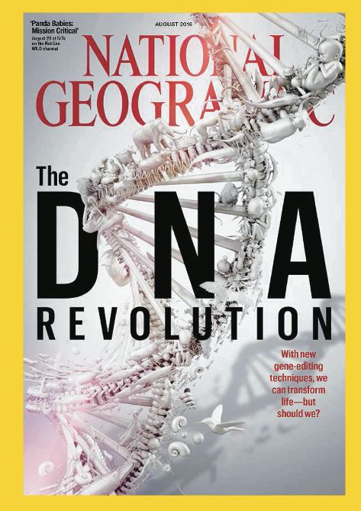
Intro to Biotechnology
Lect. 1
What is Biotechnology?

Slide 2

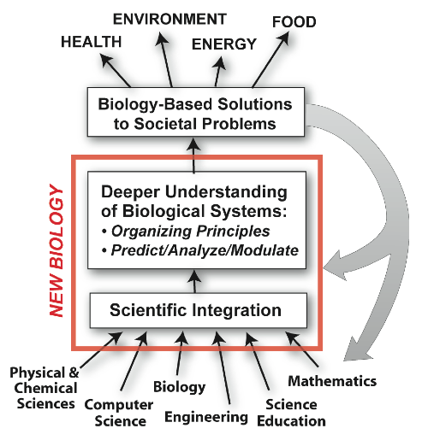
Intro to Biotechnology
Lect. 1
What is Biotechnology?
National Academy
of Sciences
Tech
Bio

Slide 3
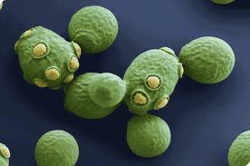
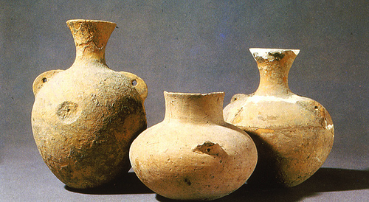
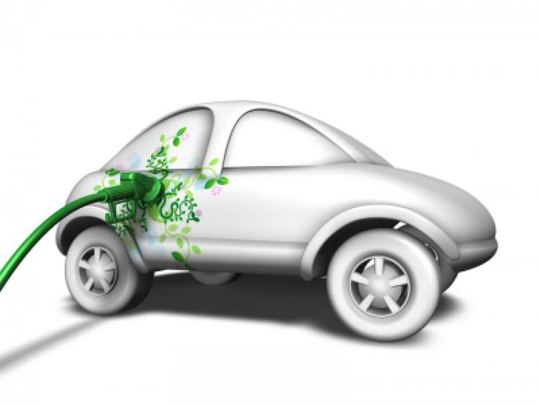
Intro to Biotechnology
Lect. 1
What is Biotechnology?
Fermentation
1919
Karl Ereky
“Using or altering biological systems
for specific purposes.”
7000 BC
How old of a field??
Jiahu, China
grapes, rice, honey
Advent of Molecular Biology
revolutionized
Biotechnology!
Biofuels

Slide 4
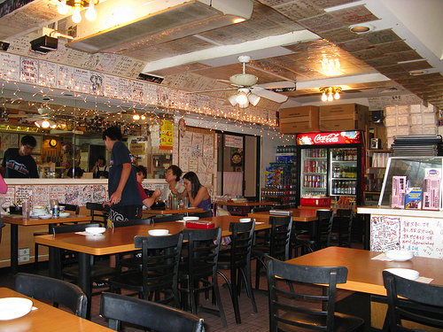
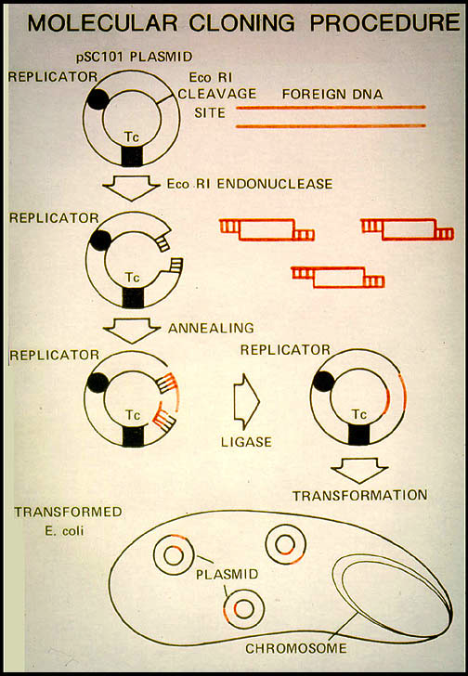
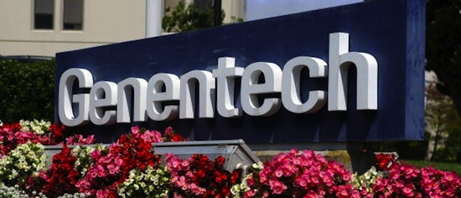
Intro to Biotechnology
Lect. 1
Advent of Molecular Biology
revolutionized
Biotechnology!
1972
Stanley Cohen (plasmids)
+
Herbert Boyer (restriction enzymes)
EcoR1
1980
Cloning Patent
Stanford & UC
Molecular Biology genetic/cellular “engineering”
1st Modern Biotechnology Company
1976

Slide 5
Intro to Biotechnology
Lect. 1
What is Biotechnology?
“Using or altering biological systems
for specific purposes.”
Examples?
• Medicine
• Agriculture
• Industry
• Marine
• Environment
• Research

Slide 6
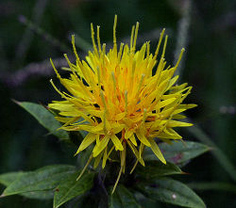
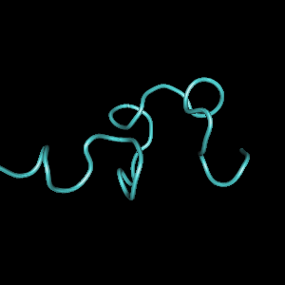
Intro to Biotechnology
Lect. 1
Medicine – therapeutics
Problem – Diabetes
Solution – Insulin
How produce?
“At these levels we can produce over one kilogram of insulin per acre of safflower production, which is enough to supply 2,500 patients for one year of treatment. We believe that we could meet the world's total projected insulin demand with less than 16,000 acres of crop production.”
Problem – Infection
Solution – Synthetic Biology?
Pseudomonas aeruginosa: pathogen
• respiratory and GI infections
007 E. coli: Licensed to kill

Slide 7
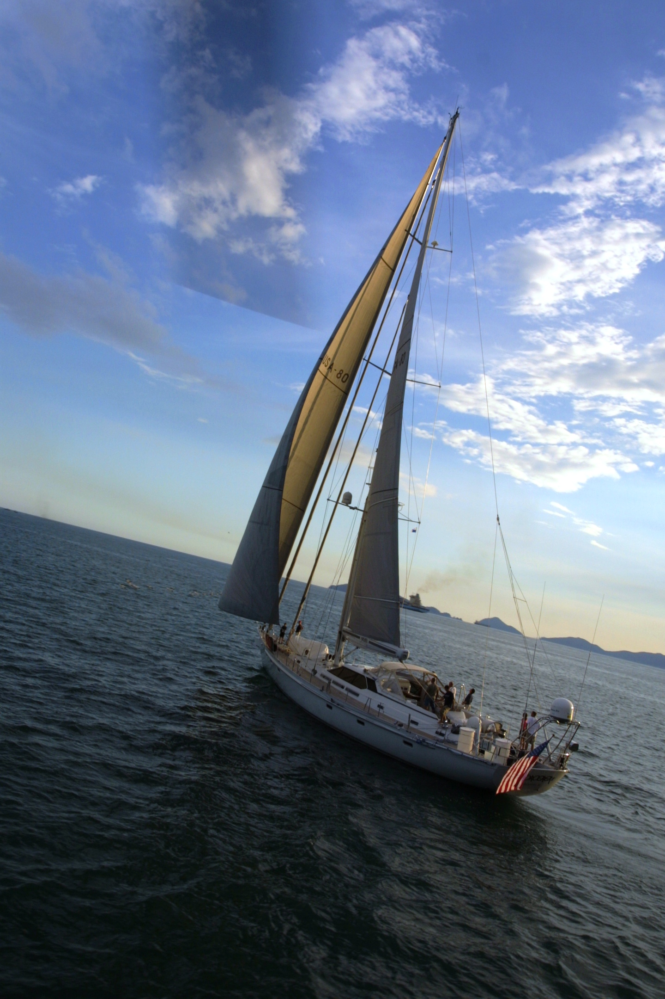
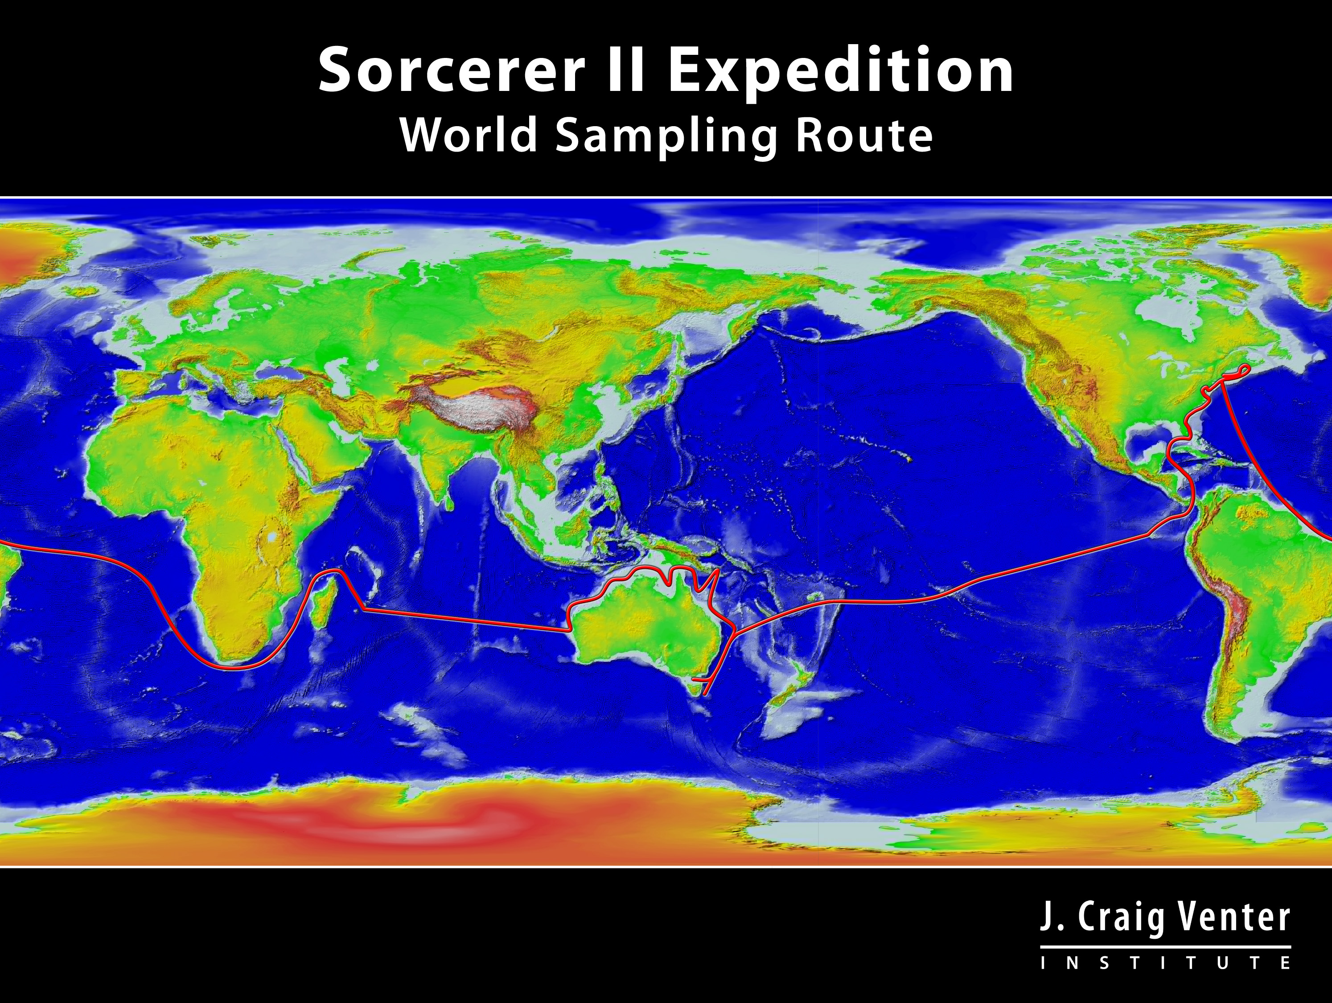
Intro to Biotechnology
Lect. 1
Environment
Problem: Monitor Impact of Environmental change
Solution: Metagenomics
Sorcerer II voyage:
- global genome sequencing
- ecosystem characterization/monitoring
- molecular based identification of new species
WHY???
Environment – bioremediation …
“Our findings show that the influx of oil profoundly altered the microbial community by significantly stimulating deep-sea" cold temperature bacteria that are closely related to known petroleum-degrading microbes, Hazen reported.”

Slide 8
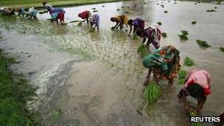
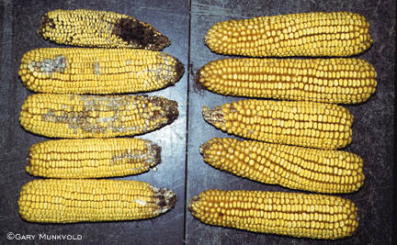
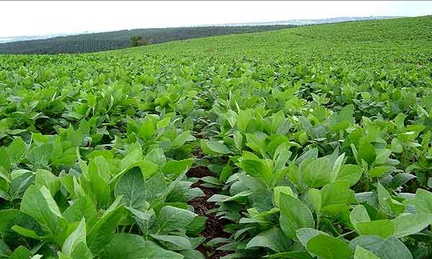
Intro to Biotechnology
Lect. 1
Agriculture
Problem – Insects, environmental conditions
Solution – Resistance, environmental tolerance
Low ₁₅ P
% ?
Key questions:
• What is the objective?
• How do we do this?
• What must we know?

Slide 9
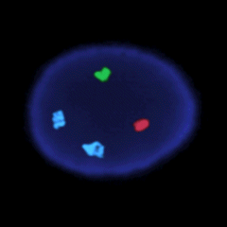
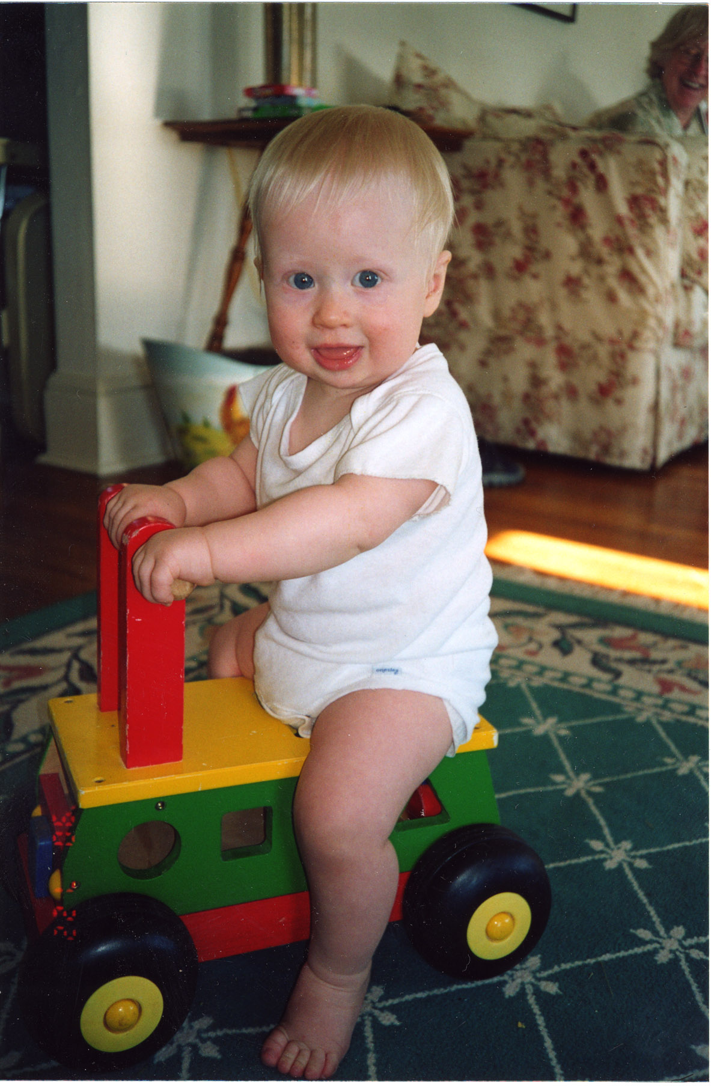
Intro to Biotechnology
DNA
Lect. 1
Genotype
Must have some basic understanding of
relevant biological system!
gene
chromosome
mRNA
genome
Environment
transcriptome
proteome
proteins
cell
organism
Phenotype

Slide 10
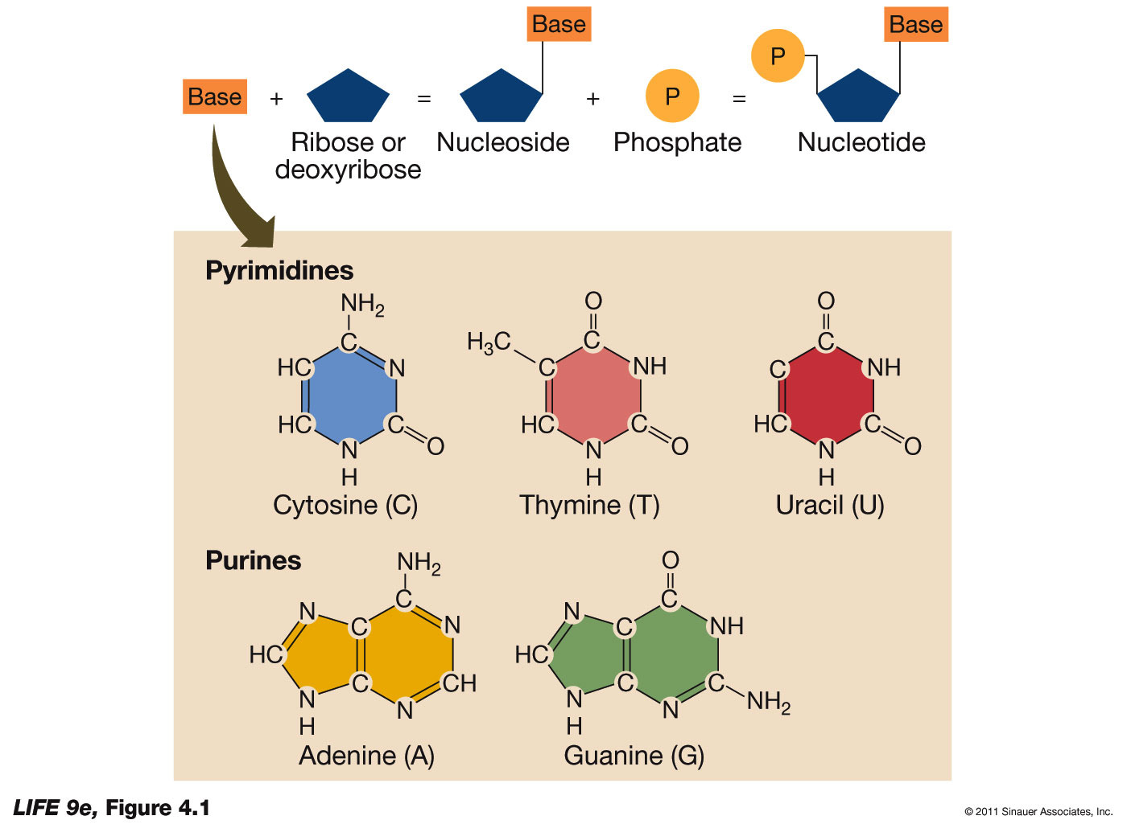
Intro to Biotechnology
Lect. 1
Must have some basic understanding of relevant biological system!
Nucleic Acids: 3 components

Slide 11
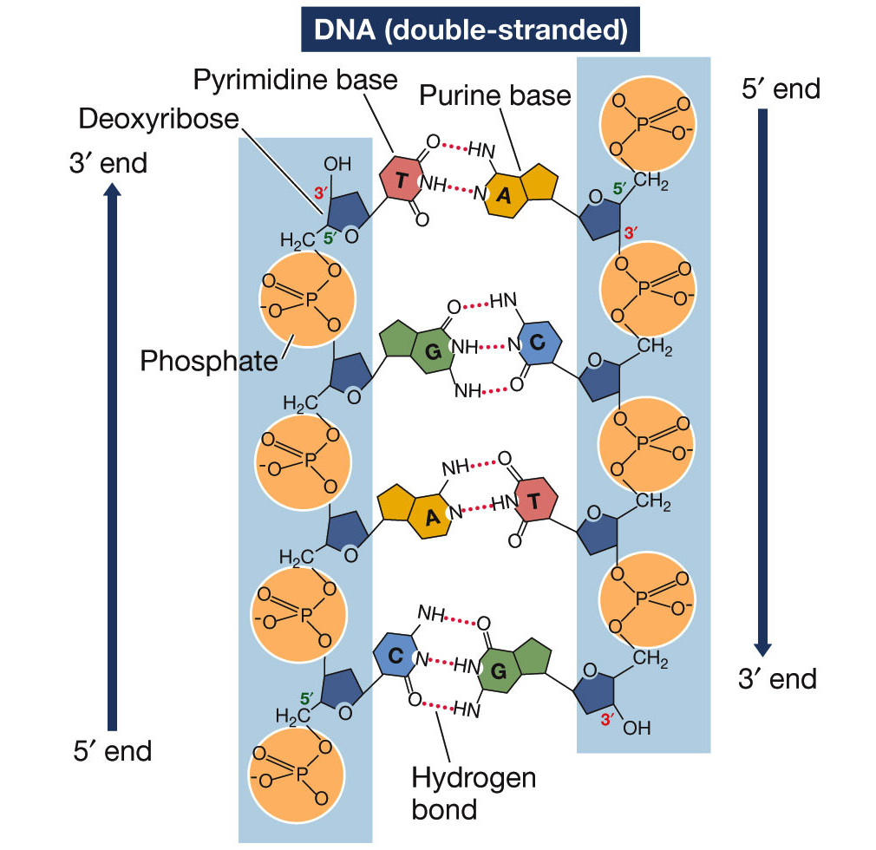
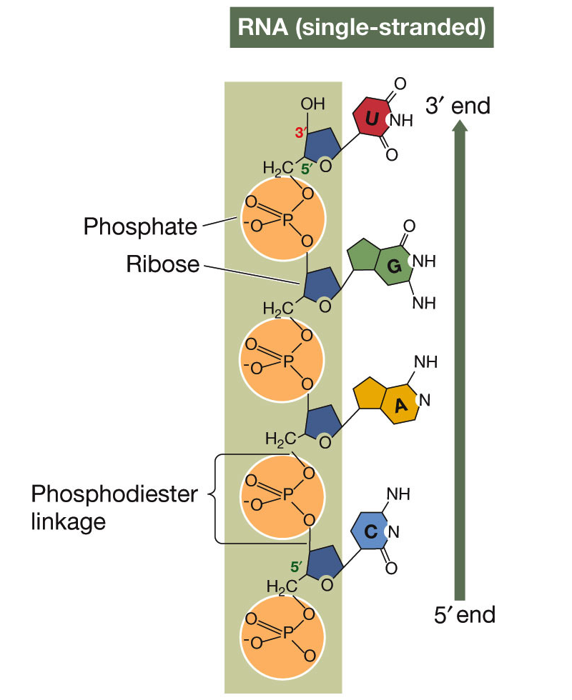
Intro to Biotechnology
Lect. 1
Must have some basic understanding of relevant biological system!
Nucleic Acids: RNA vs DNA
• Complementarity
• Bonding

Slide 12
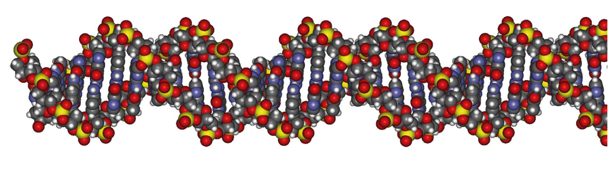
Intro to Biotechnology
Lect. 1
Must have some basic understanding of relevant biological system!
What constitutes a gene?
molecular
genetic
- NTs
- txn units
- regulatory regions
- spacer nts (fxn?)
- Genes w/in genes
- Exon sharing
RE sharing
smORFs (flies – humans)
Features of a gene?
prokaryotic
vs
eukaryotic
vs
viral
• transcription unit • regulatory region
1. 5’UTR
2. Exons
3. Introns
4. 3’UTR
1. Promoter
2. enhancer
3. silencer
4. terminator

Slide 13
Intro to Biotechnology
Lect. 1
Must have some basic understanding of relevant biological system!
DNA
gene
chromosome
mRNA
genome
transcription
transcriptome
Open Reading Frame!
• genetic code
• start/stop
translation
proteome
proteins

Slide 14
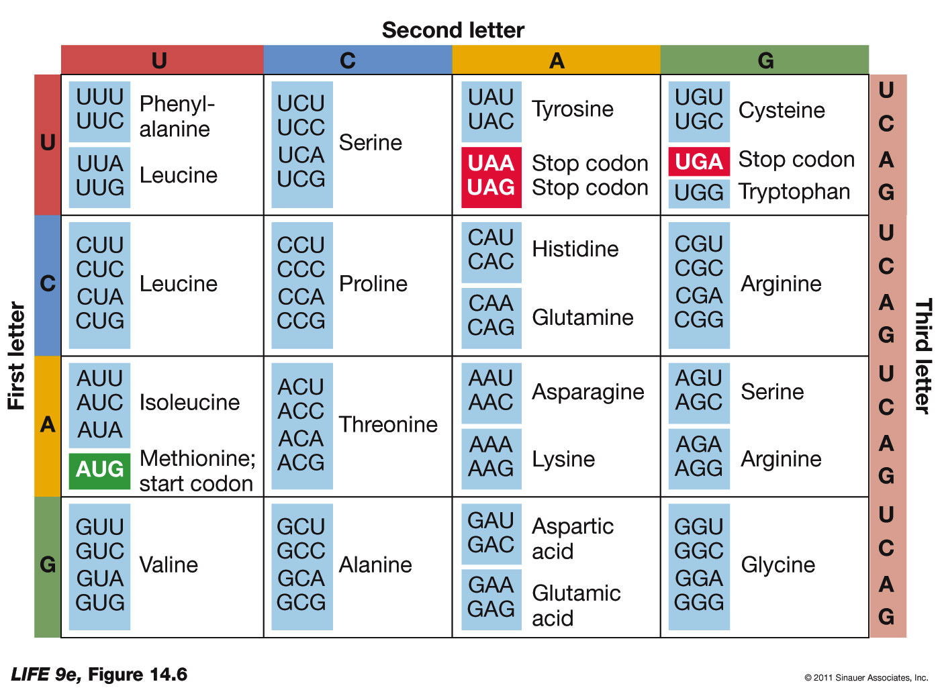
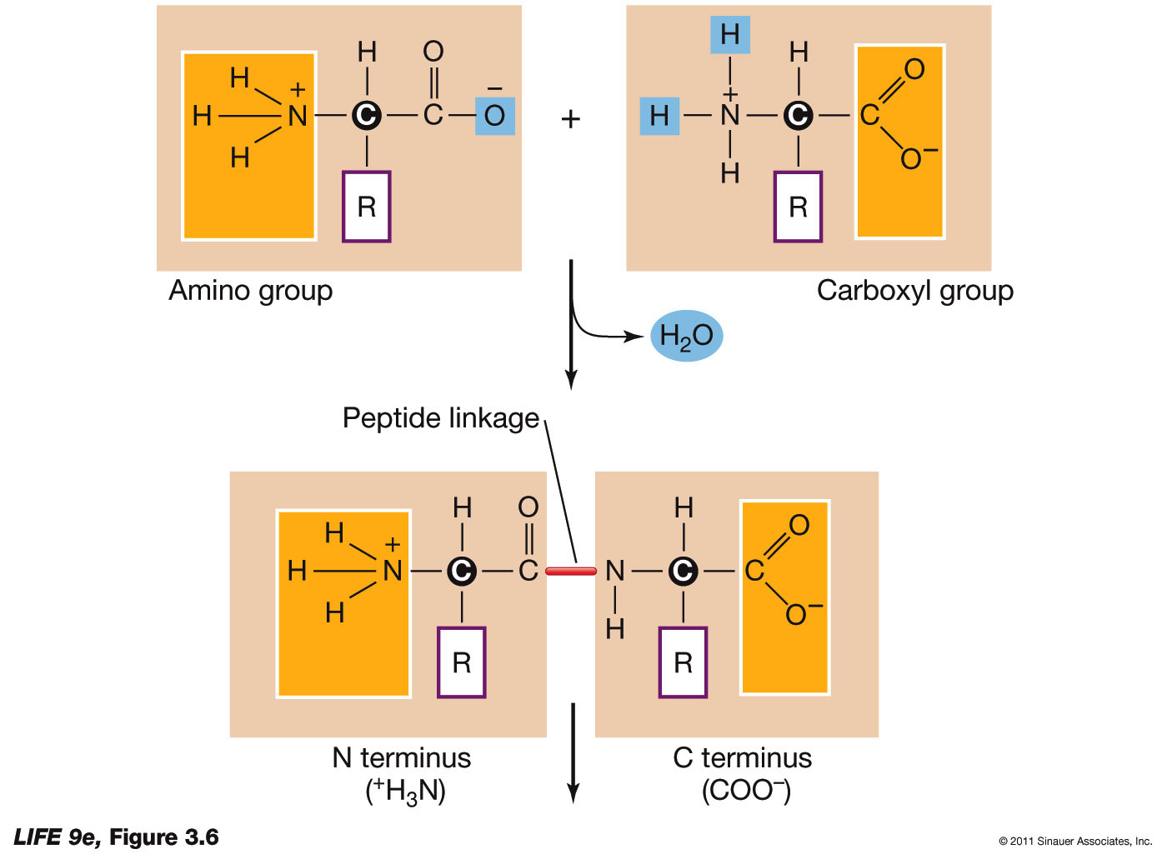
Intro to Biotechnology
Lect. 1
Must have some basic understanding of relevant biological system!
transcriptome
translation
Open Reading Frame!
• genetic code
3nt = amino acid
• start/stop
proteome
proteins

Slide 15
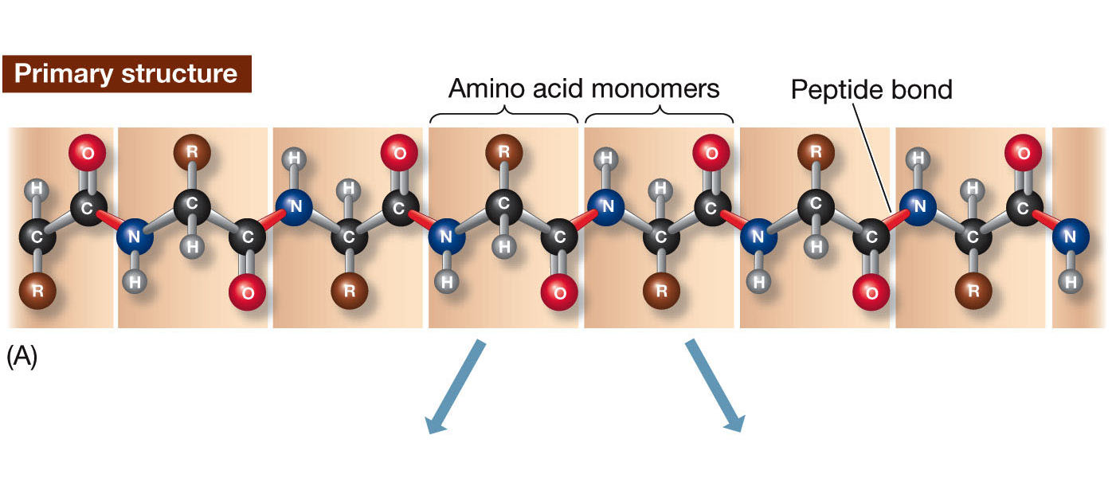
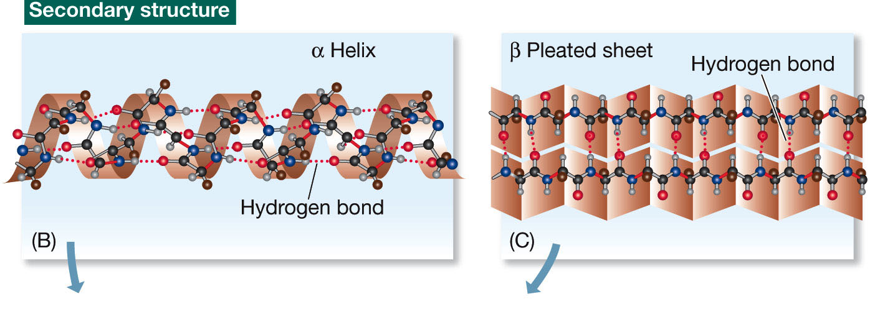
Intro to Biotechnology
Lect. 1
Must have some basic understanding of relevant biological system!
transcriptome
translation
proteome
proteins
local

Slide 16
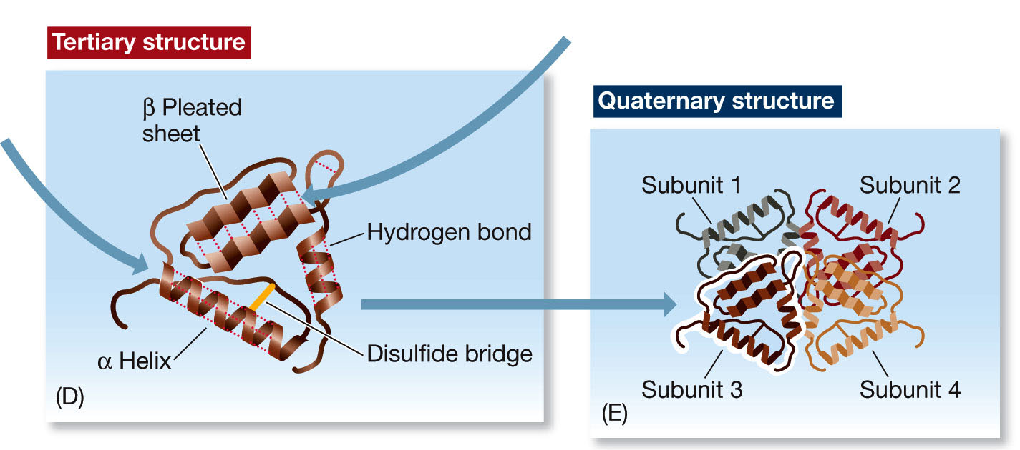
Intro to Biotechnology
Lect. 1
Must have some basic understanding of relevant biological system!
translation
proteome
proteins
Activity!

Slide 17
Intro to Biotechnology
DNA
Lect. 1
Genotype
Must have some basic understanding of
relevant biological system !
gene
chromosome
mRNA
Mechanisms for altering
• genetics (breeding – historical)
• molecular biology
• biochemistry
• synthetic biology
• chemical genetics
• etc…
genome
Environment
transcriptome
proteome
proteins
cell
organism
Phenotype

Slide 18
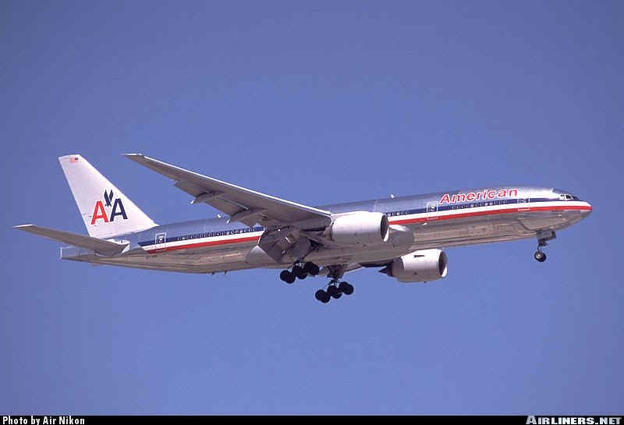
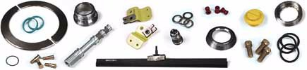
Intro to Biotechnology
Lect. 1
Systems Biology
The list of parts is a necessary but not sufficient condition for understanding biological function.
Understanding how parts work is important, but not sufficient - how do they work together?
Systems biology: global study of multiple components
of biological systems and their interactions.

Slide 19
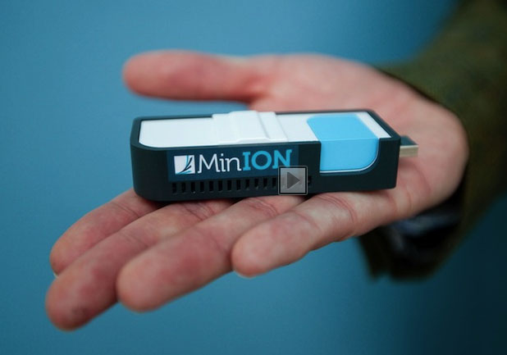
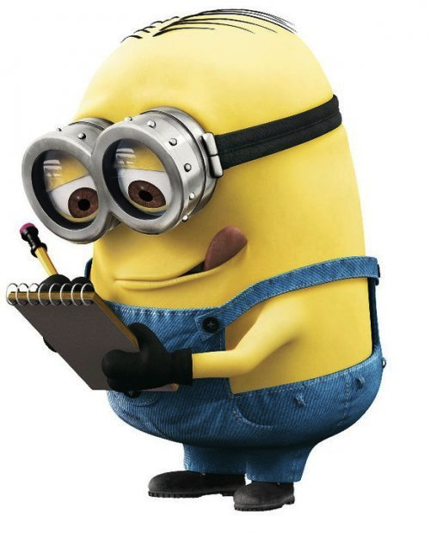
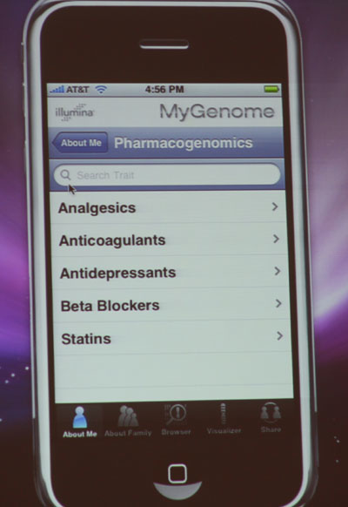
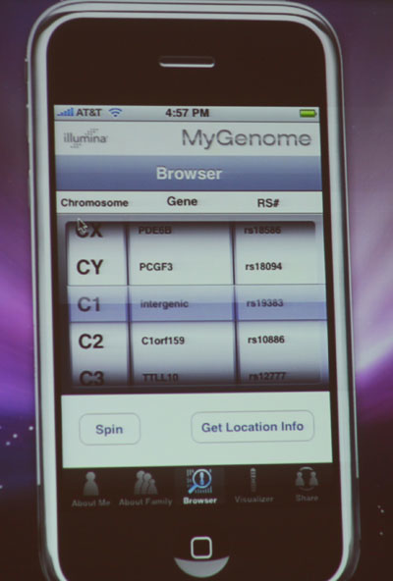
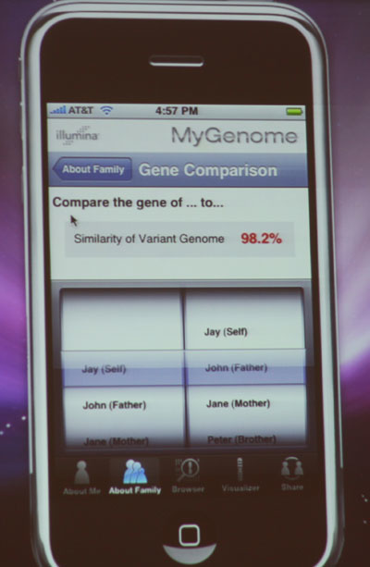
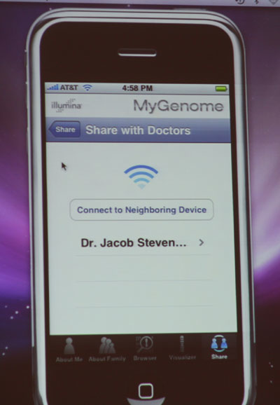
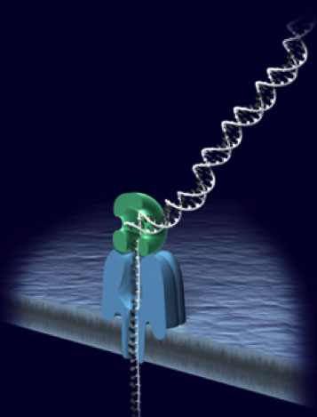
Intro to Biotechnology
Lect. 1
Genomics
Personalized medicine:
• 2003 - human genome sequence - $3 billion
• 2015 - human genome sequence - ??
~$1K
Discounts for:
• serious medical condition
• groups from same doctor
Genome on a phone…

Slide 20
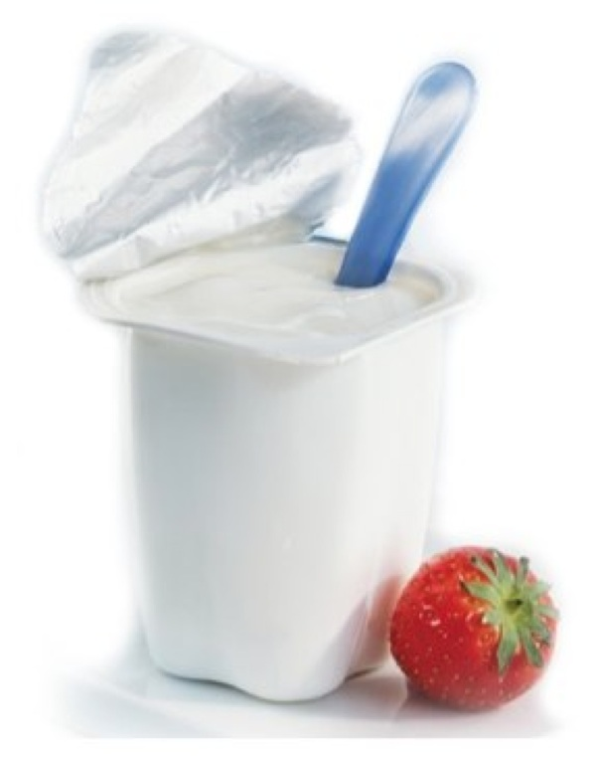
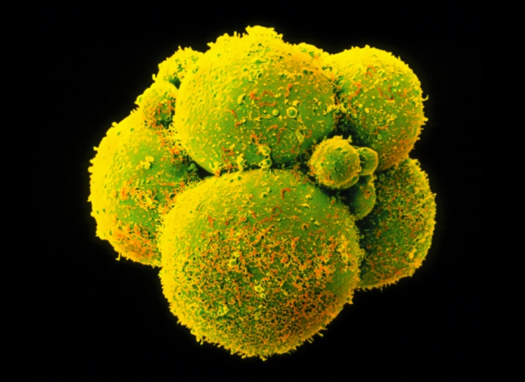
Intro to Biotechnology
Lect. 1
Genomics
Personalized medicine:
• Genome sequence reveals mutations
- treat symptoms
vs
cause
Genome Editing/Engineering

Slide 21
Intro to Biotechnology
Lect. 1
What is Biotechnology?
“Using or altering biological systems
for specific purposes.”
Key questions:
• What is the objective?
• How do we accomplish this?
Synthetic Biology
Systems Biology
Molecular Biology
Genome engineering
• What must we know?
Biology of system

